Slide 1
Project Competition
Andrew Wilson, Greg Lozada, Guilherme Pereira,
Jake Sherman, Jordan Moses, and Jordan Sasek
Notes:
Jordan

Slide 2
Project Overview
Recreational sports league management system
Create an account
Become a Manager, player, or just a spectator
Any account can follow teams, view events, and comment on team pages
Managers create and manage teams
Players join teams
Edit account, team, or event info
Get the latest news on teams and upcoming events
View scores from previous and ongoing games
Notes:
G

Slide 3
Roles
Efforts
Front End:
Lead Designer: Guilherme Pereira
Andrew Wilson
Back End:
Lead Back End: Gregorio Lozada
Jordan Moses
Jordan Sasek
Jake Sherman
24 Classes
12 Controllers
1 Interface
1 Main Class
11 Screens
Lines of Code: 3817 (According to the Statistic plugin in IntelliJ)
Notes:
Andrew

Slide 4
Video
https://www.youtube.com/watch?v=6ikH_bcFbsI&feature=youtu.be
Notes:
Greg

Slide 5
Known Issues/Requirements
Text files that back up data can be manipulated externally
No verification for certain actions:
Remove player from team
Cancel/Deactivate events
Changing account tier from Manager to anything else (Deletes Manager account’s team if user goes through with their edits)
PNGs are the only allowed file type for profile pictures
Most requirements were met
Some small edits had to be made to make requirements more specific (About 6)
Three had to be omitted due to feedback or were too large scale compared to the project scope
Notes:
Jake

Slide 6
Challenges
Time management:
Finding time where most group members could meet
Certain JavaFX nodes:
ListViews
ContextMenu
What we’d do differently:
Use a database rather than text files
Have a stronger start
Notes:
Moses

Slide 7
Thank you for listening! Any Questions?
Notes:
Jordan

Slide 8
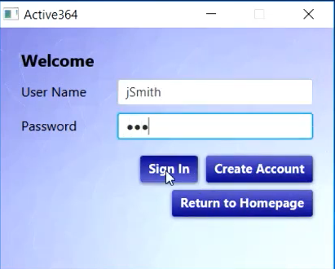
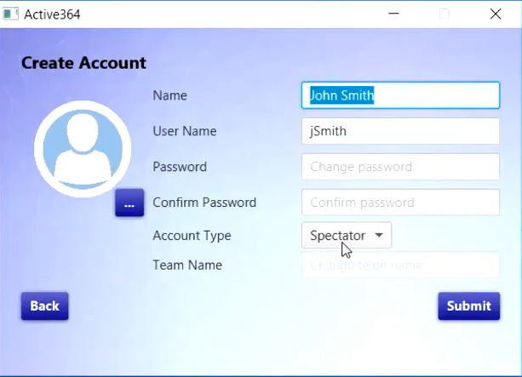
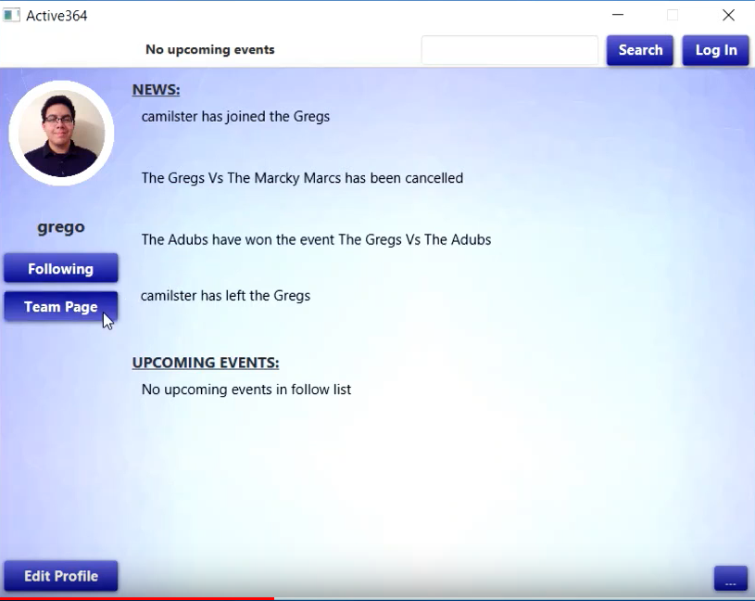
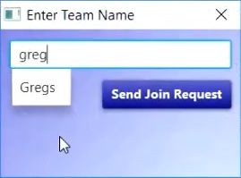
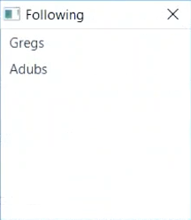
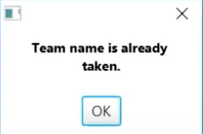
Screenshots 1
Login
Create Account/Edit Account
Homepage
Join Team
Following
Message Box

Slide 9
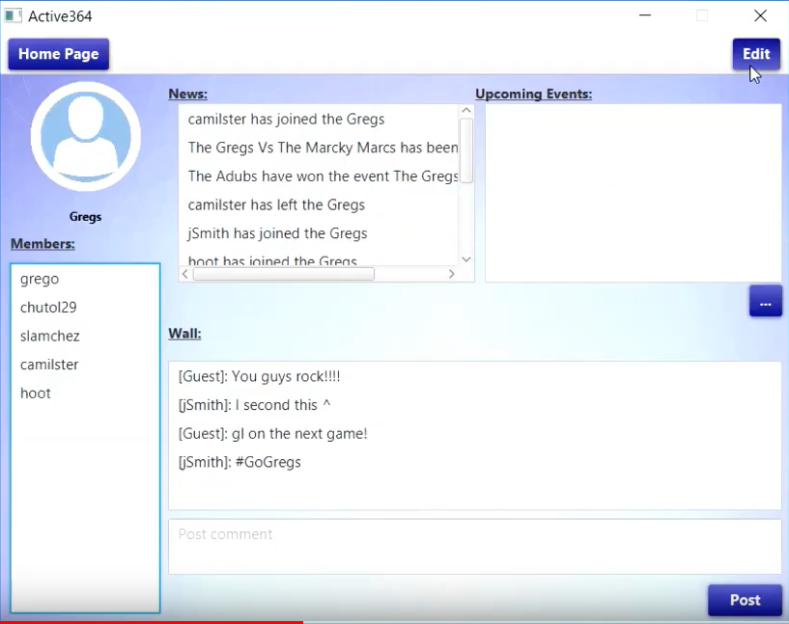
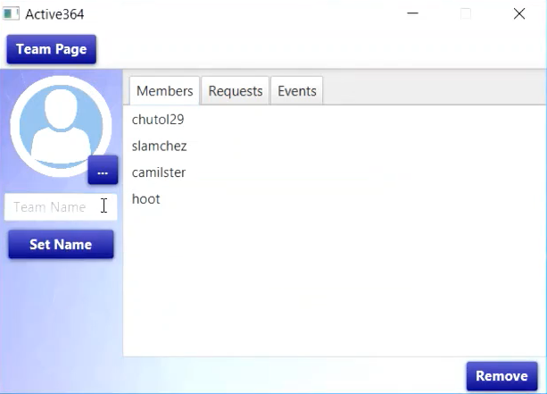
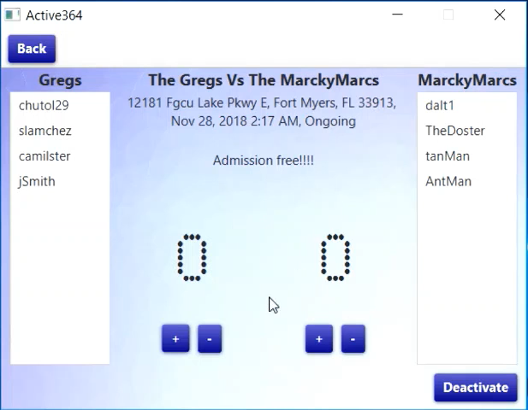
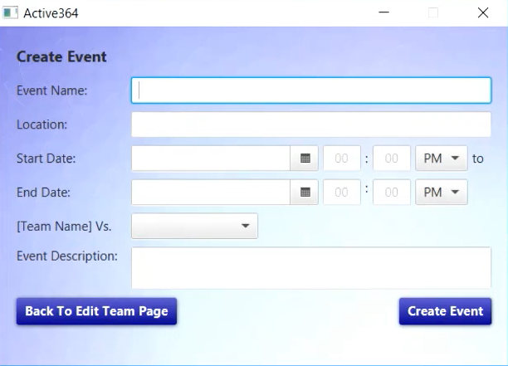
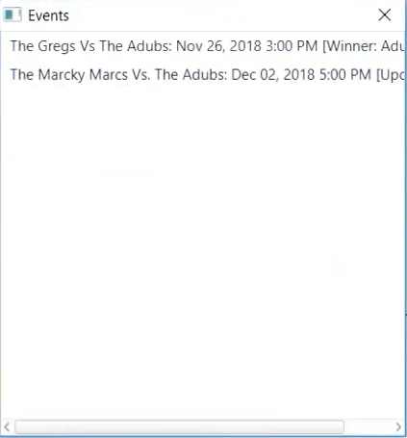
Screenshots 2
Team Page
Edit Team
Event Page
Create Event/Edit Event
Events List

